Slide 1
Social Media Analytics on Twitter Content
Nilakshi Roy Asst Prof. Boppuru Rudra Prathap
1427111

Slide 2
Problem Statement:
Social media analytics is a way where huge data is gathered and analyzed. Problem statement as follows
Social media data should be structured and stored in a database.
For analyzing the data, sentiment analysis or opinion mining can be done.
Predictive analysis such as identifying and predicting future outcomes and behaviors based on historical data collected over time.

Slide 3
Objective:
Collecting streamed tweet ,preprocessing of the raw tweets through the different levels of data warehouse components and creating Twitter Data Warehouse.
Tweets are analyzed by sentiment analysis using naïve bayes classifier.
Creating proper facts and dimension table to represent the data in an multidimensional model, i.e OLAP cube.
Predictive analysis is done for the future analysis of the data over a time period.

Slide 4
Literature Survey:
Literature survey

Slide 5
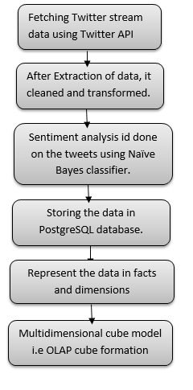
Workflow Diagram:

Slide 6
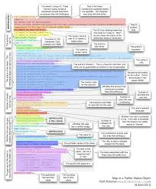
Methodology:
Fetching raw tweets:
Twitter API allows to fetch the raw tweet . Through python code I have directly fetched the data in to the database, PostgreSQL where all the twitter meta data is stored in a structured way.

Slide 7
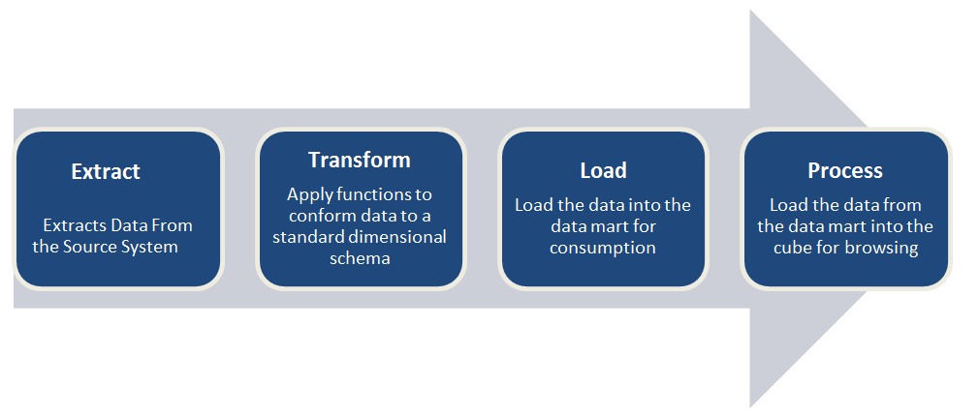
Methodology:
ETL process:
When tweets are fetched they comes in json format. To remove inconsistency of data, data is cleaned and preprocessed called the ETL stage.
Here as I have taken the meta data of the twitter and directly inserted in to the postgreSQL, this step is passed.

Slide 8
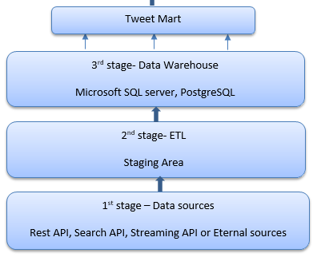
Methodology:
Twitter Data Warehouse:
As the data is stored in postgreSQL ,data is represented in facts and dimensions and stored in tweet mart for further analysis.

Slide 9

Methodology:
Analysis of data:
Sentiment analysis is done on the tweets using naïve bayes classifier. Naïve bayes classifier has sets of training set, which trains the test set data.
where d are the individual words in the document and ci belongs to the particular class of the word in the document. This classifier gives the output class with the maximum accuracy of sentiments.
$$p(c_{i}|d)=\underset{}{\begin{matrix}\overset{̲}{\left.P(d|c_{i})P(c_{i}\right)} \\ \left.P(d\right)\end{matrix}}$$

Slide 10
Methodology:
Multidimensional view of data:
It has become so important to visualize and analyze the following data model to get the knowledge that can be learnt from the data. This finds the relationships between the tweets of the user and the user itself. In presentation area if the data is stored in the multidimenasional database, then it called OLAP.

Slide 11
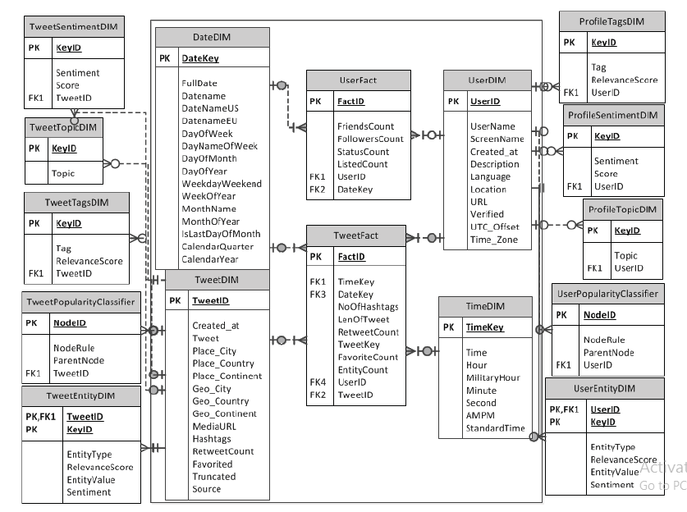
Methodology:
Multidimensional Model:

Slide 12
Methodology:
Creation of an OLAP cube:
Mondrian is an open source Online Analytical Processing server written in java , which responds to the query fast enough to allow an interactive exploration of data.
Tomcat is an application server from the Apache software foundation that executes Java servlets and renders Web pages that include Java server Page coding.
The fact and the dimension table created in the data mart are mapped and a cube XML file is created which helps to plot the cube in the Mondrian database.
Mondrian automatically creates MDX query which helps to plot the cube in the Mondrian.

Slide 13
Methodology:
Trend Analysis:
Social analytics are divided into two parts where first is
Listening-which really means ingesting, aggregating, and adding metadata to social media feeds
Next is monitoring and analysis which entails looking for trends over time such as changes in sentiment, retweet counts, followers count. This analysis are often expressed as a series of short term trends usually three months or less, attempting to detect a change in graphical color.

Slide 14
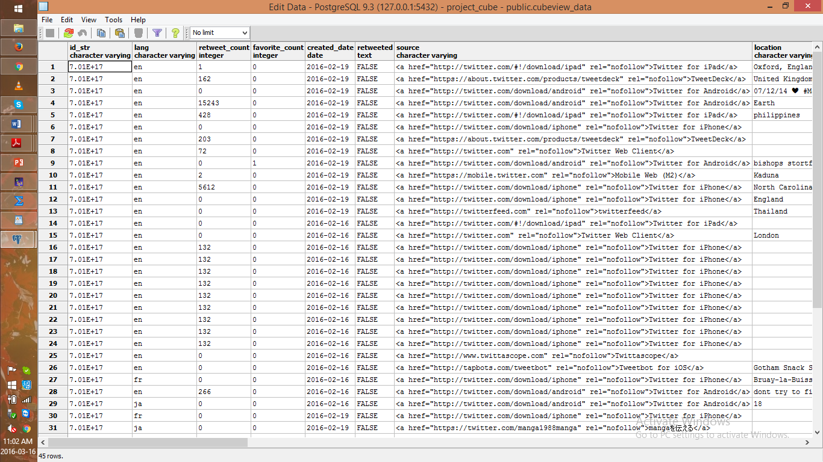
Results and discussions:
Data stored in PostgreSQL:

Slide 15
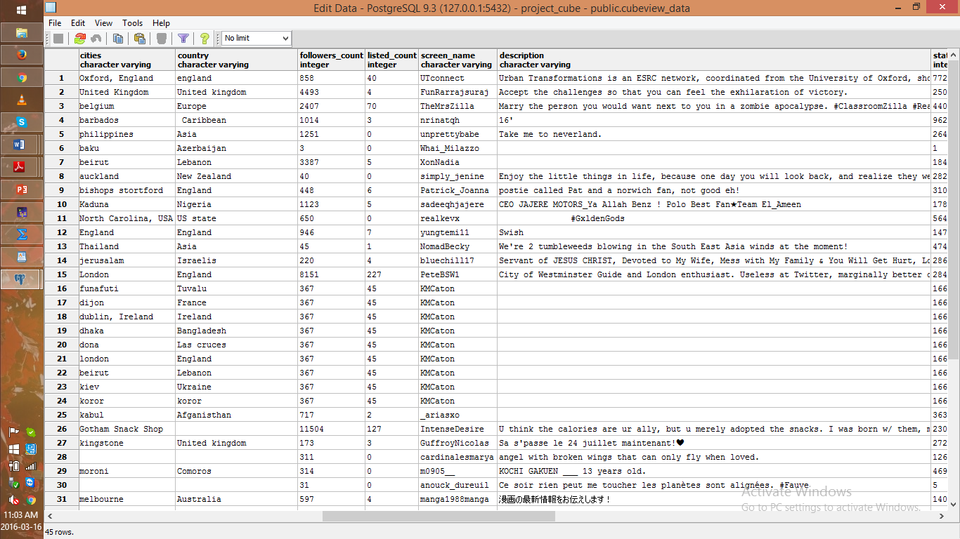
Results:

Slide 16
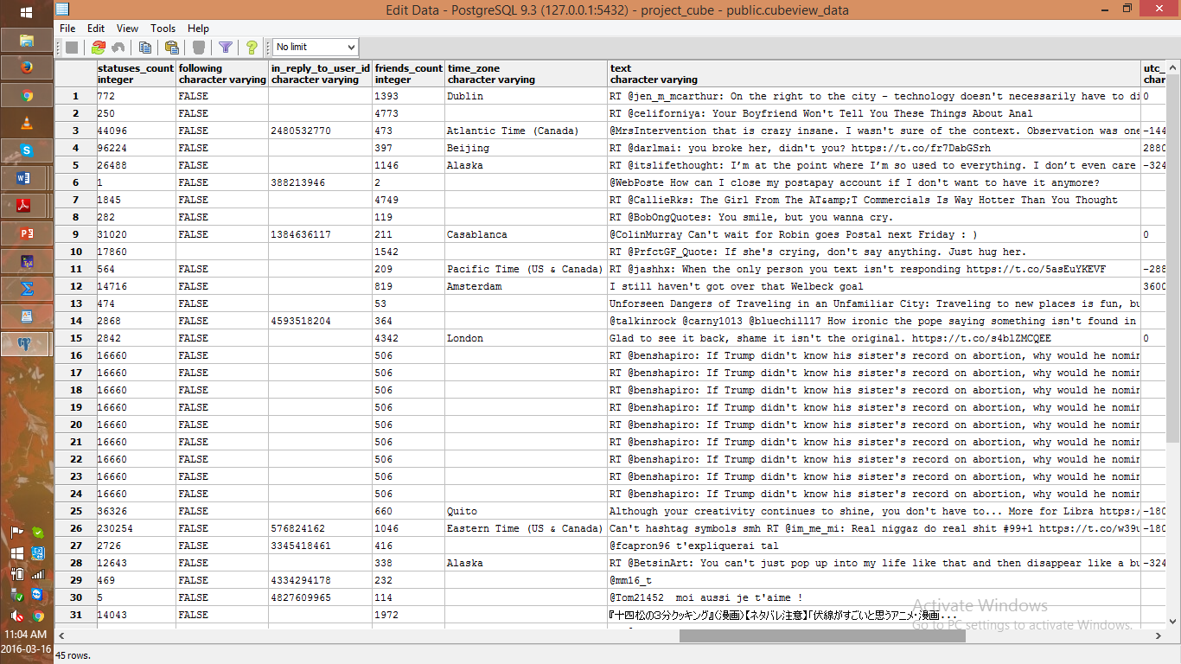
Results:

Slide 17
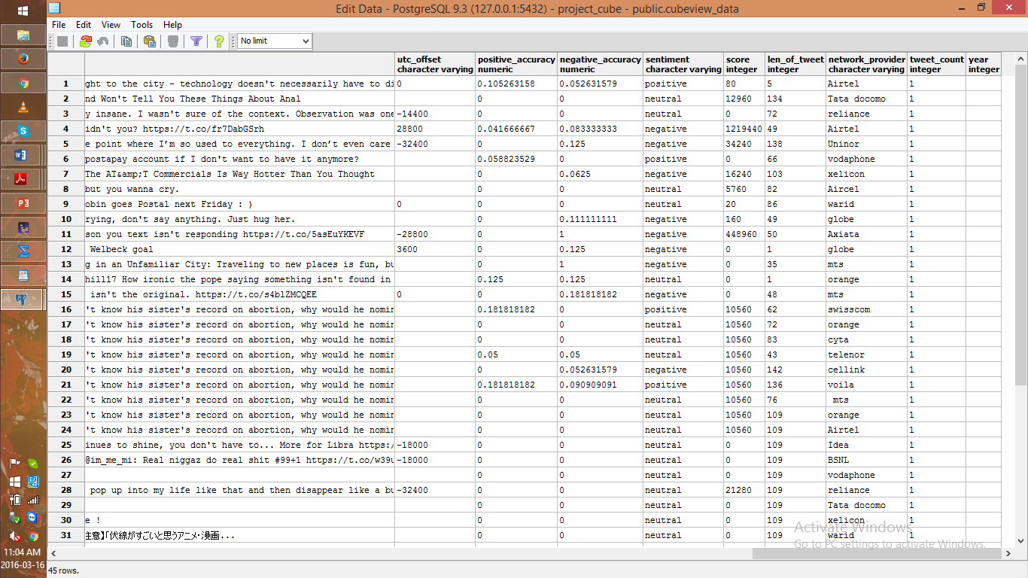
Results:

Slide 18
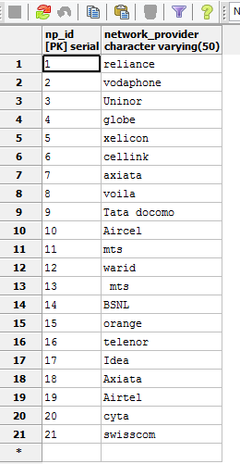
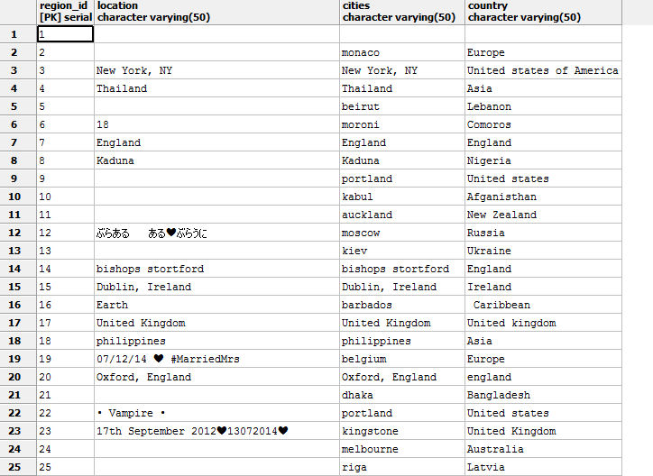
Results:
Related dimension tables:

Slide 19
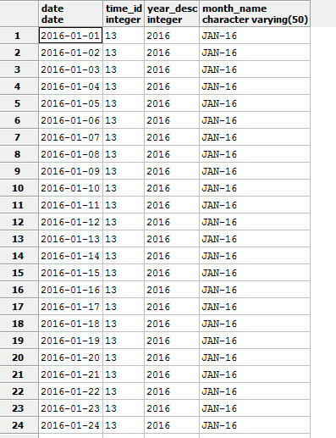
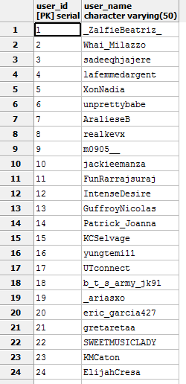
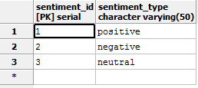
Results:

Slide 20

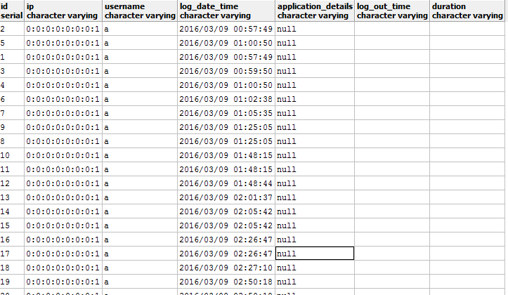
Results:

Slide 21
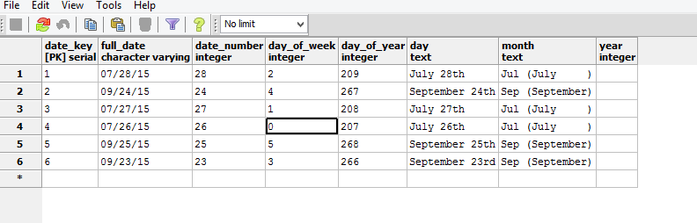
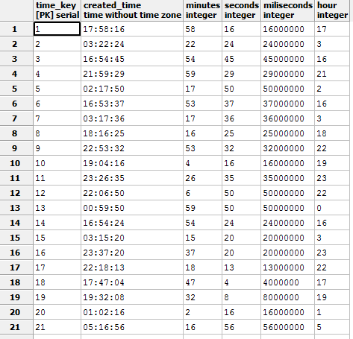
Results:

Slide 22
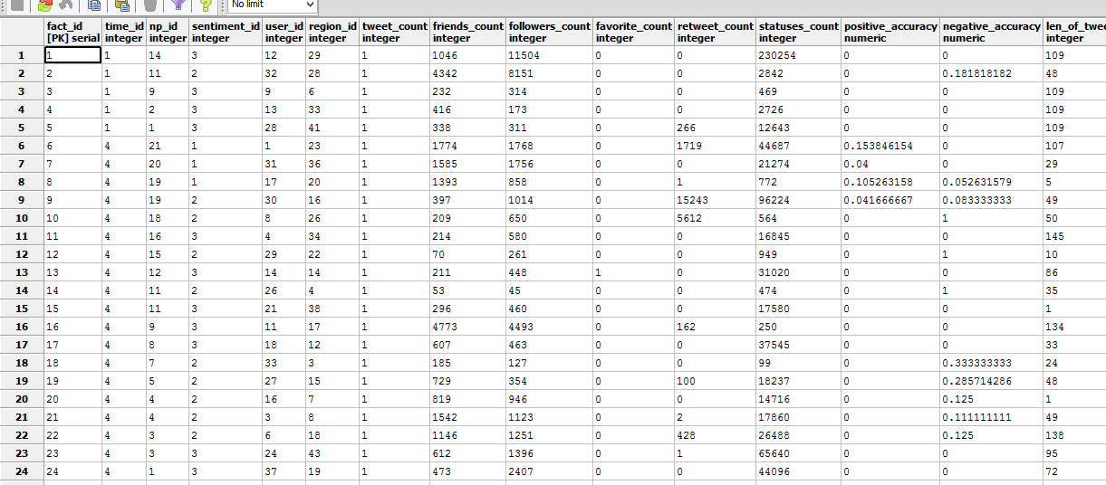
Results:
Fact table for cube view:

Slide 23
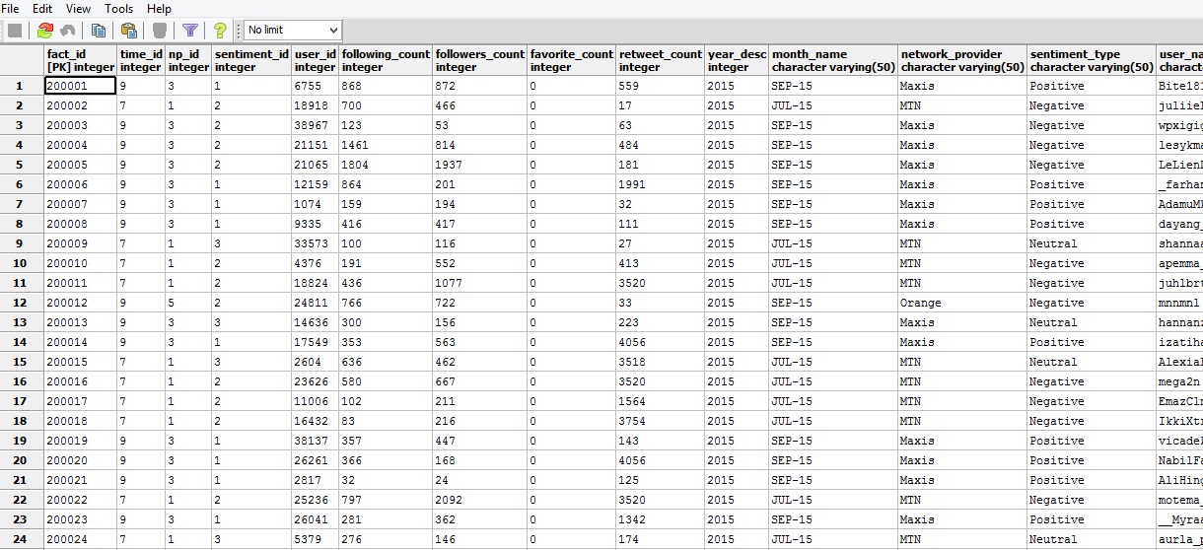
Results:
Fact table for trend view:

Slide 24
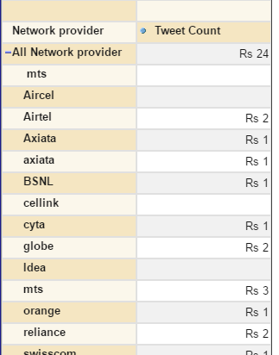
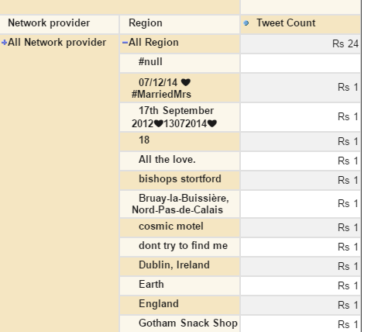
Results:

Slide 25
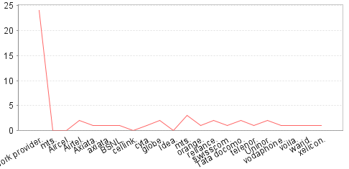
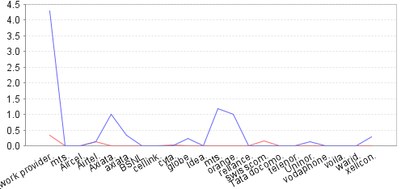
Results:
Network Provider with Tweet count
Network provider with sentiments

Slide 26
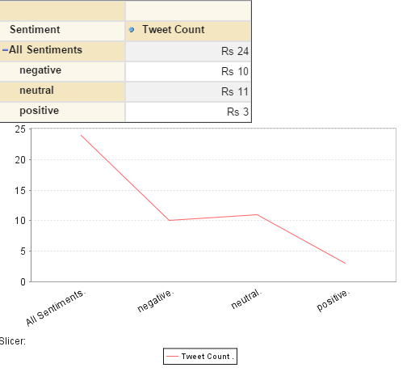
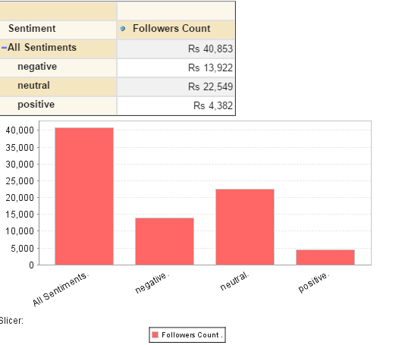
Results:
Sentiment with Tweet count
Sentiment with Followers count

Slide 27
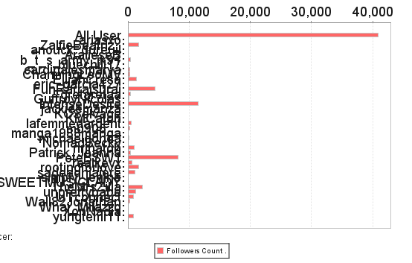
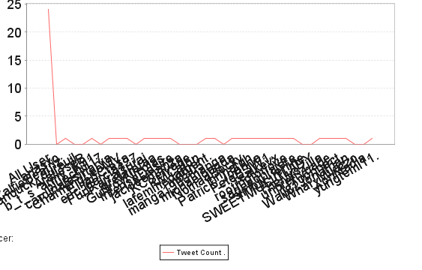
Results:
User name with Followers count
User name with Tweet count

Slide 28
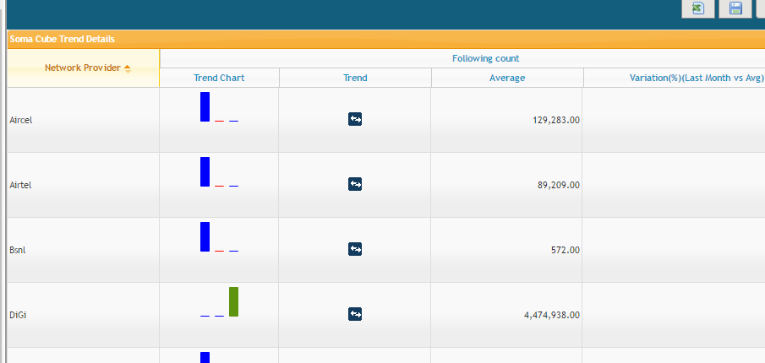
Results:
Trend view

Slide 29
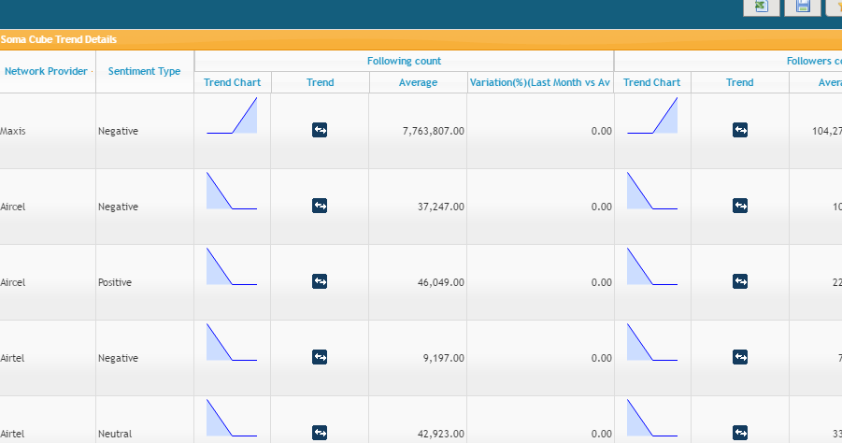
Results:
Trend View Line charts

Slide 30
Conclusion:
Data warehousing technology supports the study of huge data volumes caused by Twitter. We represent multi-layered system architecture which shows how to transform the data collected from twitter and the detailed explained process of each layer. OLAP cube is a method which represents the data in a multi-dimensional cube view. For many business area, while taking decisions this OLAP cube could be helpful. It can store a huge amount of data where at a time, a query can hit hundreds thousands of rows. This OLAP cube is implemented which can be helpful for taking decisions, Social BI and to visualize the data for more analysis. Trend view is the way any business users can take business decisions and predictions about the future.

